Slide 1
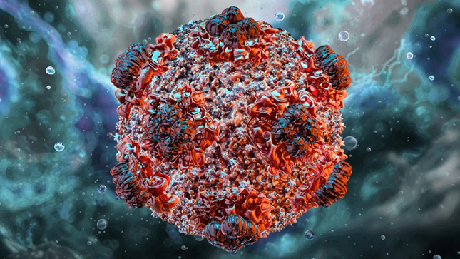


Hantavirus
8 May 2026
Catherine L. Troisi, PhD
Professor, UTHealth Houston
Co-Editor, Control of Communicable Diseases Manual

Slide 2
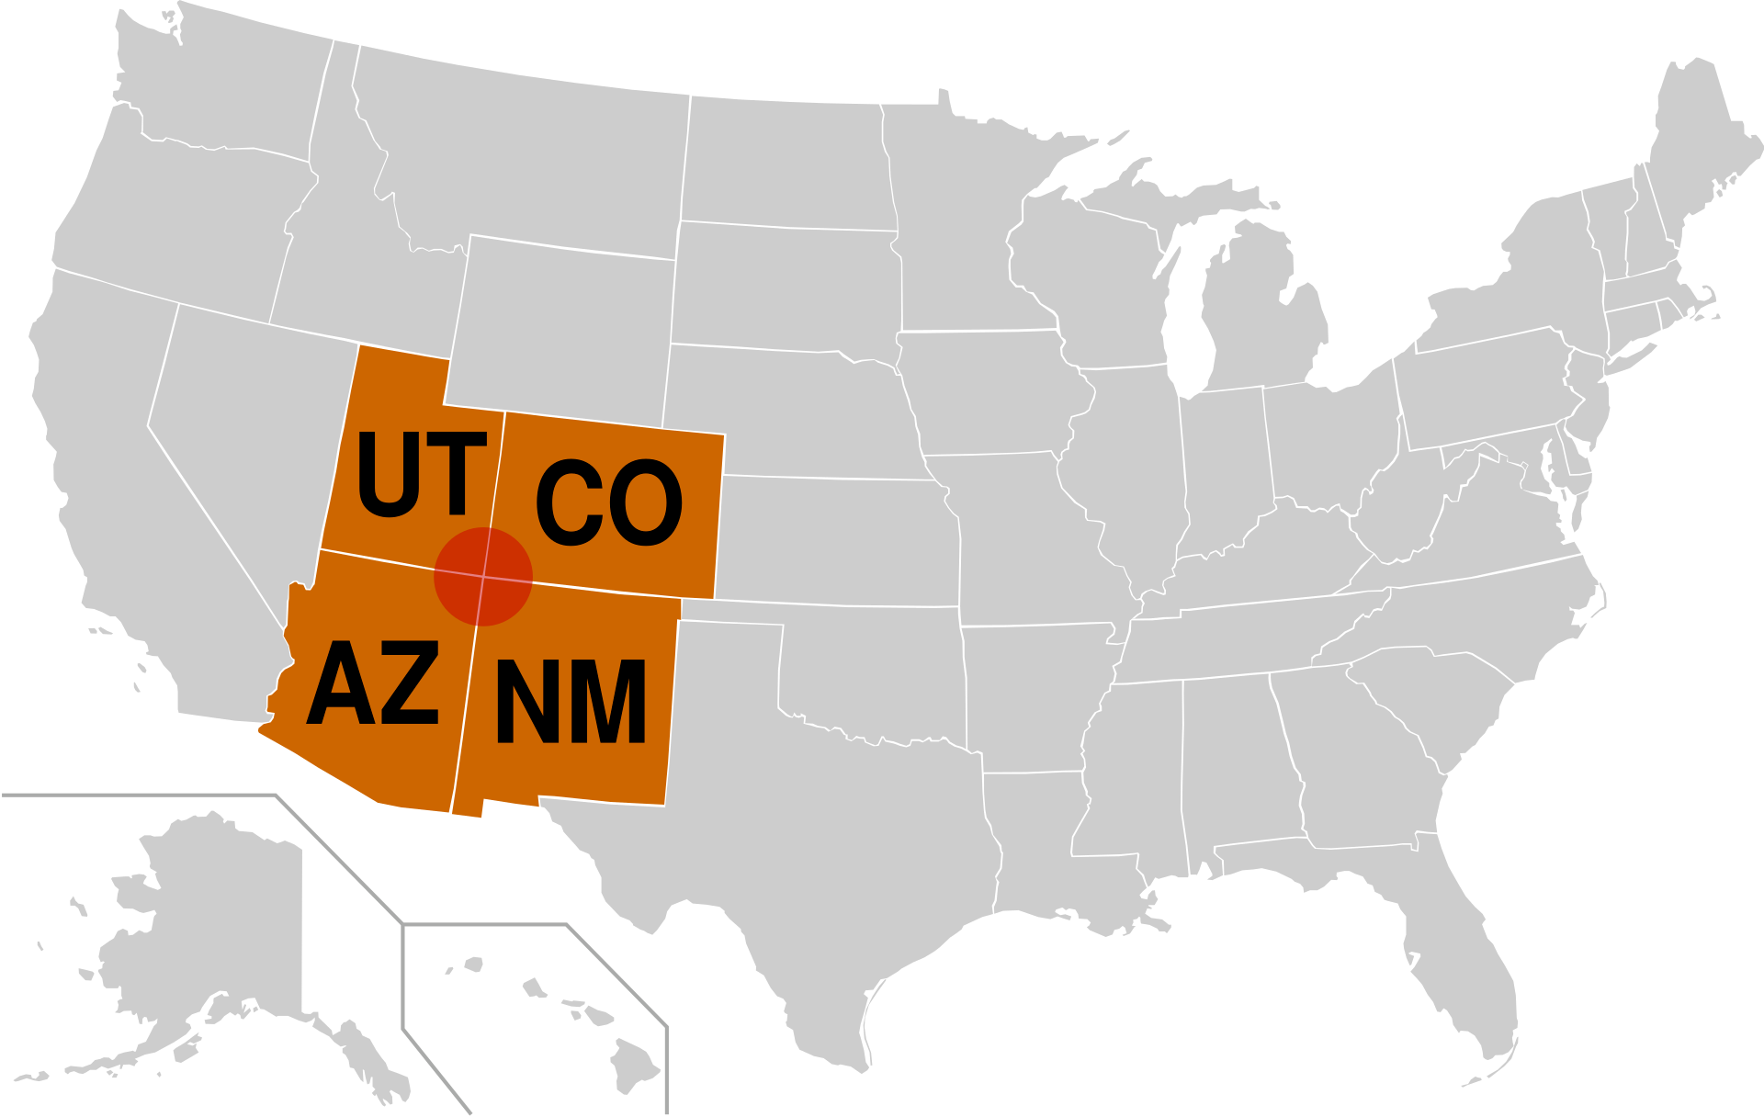

Hantavirus
The virus
Family of RNA viruses
Over 40 members, ~half infect humans
  Only a few cause severe disease
First identified early 1950s in Korea
1993 – first detected in North America
Zoonotic reservoir - rodents

Slide 3
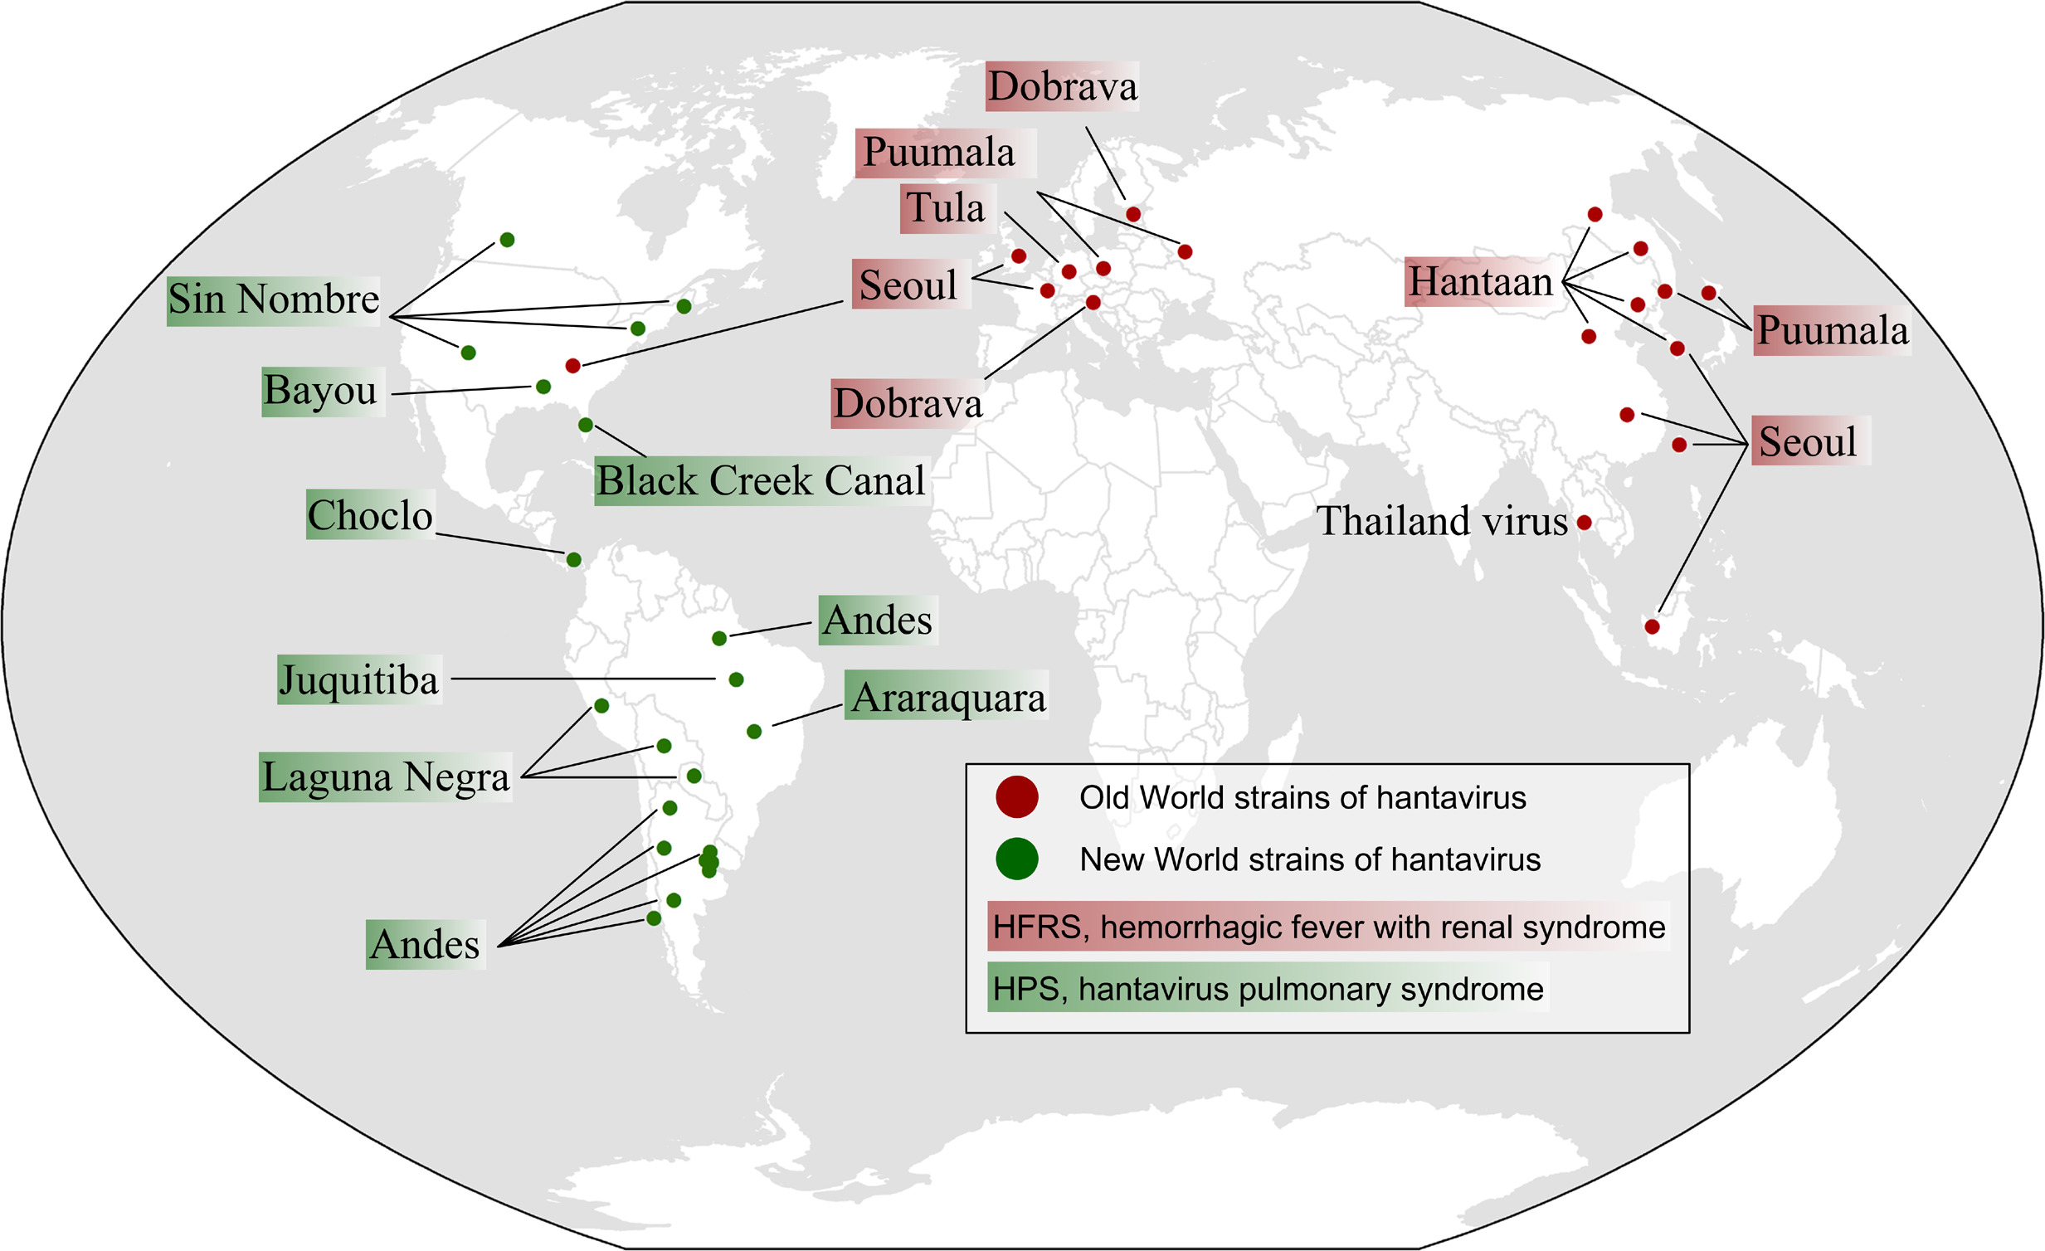

Hantavirus
Geographic distribution
Old World hantaviruses
  Europe and Asia
New World hantaviruses
  Americas
Seoul virus found world-wide
Tian, H., Stenseth, N.C., 2019 PLoS Neglected Tropical Diseases.

Slide 4


Hantavirus
Transmission
Rodent to human through respiratory route
  contact with rodent urine, feces, saliva, or bite
  Infested dwellings/cleaning of infested dwellings, agriculture, forestry
Human to human transmission only observed with the Andes virus
  Requires close, prolonged contact
  Humans are not infectious until they show symptoms

Slide 5
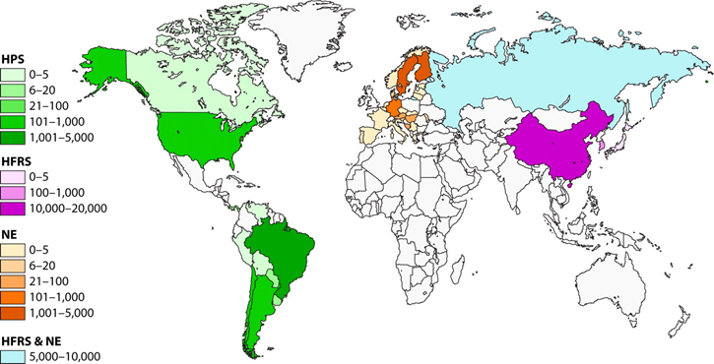

Hantavirus
Incidence
Worldwide, estimated 10K to >100K infections occur each year
  the largest burden in Asia and Europe.
  difficult to know true incidence as mild cases will not be captured
US has recorded 890 cases from 1993-2023
  Western states at highest risk
Jonsson CB, Figueiredo LTM, Vapalahti O. 2010. Clin Microbiol Rev 23:.

Slide 6
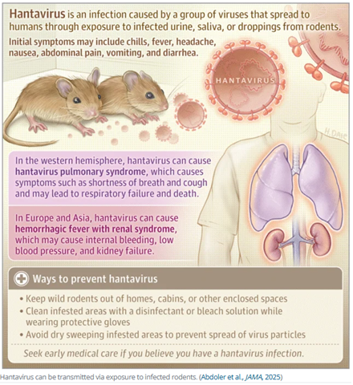

Hantavirus
Clinical symptoms
Can take 1 to 8 weeks for symptoms to occur
Starts with flu-like symptoms
Can progress to more serious disease quickly
  Old World viruses – HRS
  New World viruses – HPS

Slide 7


Hantavirus
Clinical symptoms
Estimated CFR with Europe/Asia viruses: 1-15%*
Estimated CFR with Americas viruses: up to 50%*
Blood test can detect the virus
No vaccine, no specific antiviral treatment but supportive care can reduce mortality
This Photo by Unknown Author is licensed under CC BY-SA
* True CFR probably lower as we don’t have good estimates of the total number of cases

Slide 8
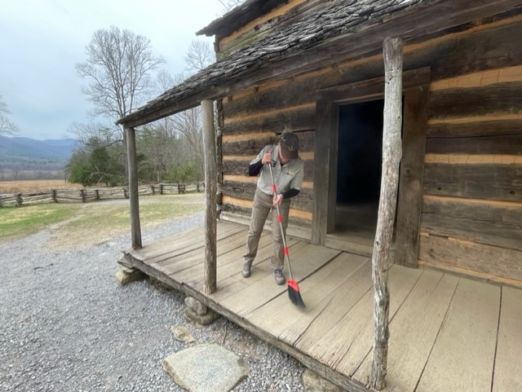

Hantavirus
Prevention methods
Eliminate or minimize contact with rodents in home, workplace, campsites
Store food securely
Avoid dry sweeping/vacuuming in areas where rodents may have been; wear N95 mask
Hand hygiene
Contact tracing

Slide 9




Hantavirus
Why this is not likely to be the next pandemic
Requires close, prolonged contact
Cases are not infectious until they show symptoms

Slide 10

Catherine Troisi, PhD
Catherine.l.troisi@uth.tmc.edu

